Slide 1
YouTube meditation
CLC Europe
Monday

Slide 2

Singing hippopotamus

Slide 3

Royal Enfield commercial:

Slide 4
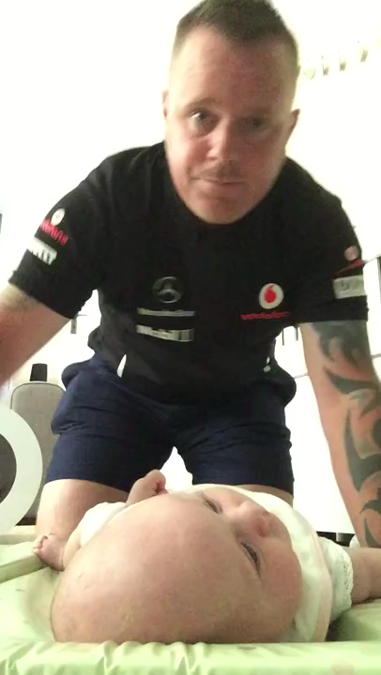
Fatherhood

Slide 5

Guided meditation

