Slide 1
Drama
A way to spirituality

Slide 2
Drama & Theatre
Etymology:
δρᾶμα (drâma): an act, a theatrical act, a play
δράω (dráō): to act, to take action, to achieve
θέατρον (théatron): a place for viewing
θεάομαι (theáomai): to see, watch, observe
Notes:
drama – working on 2 levels - i. action, ii. performing, doing an action and being witnessed/seen
action, choices,
hypocrites: actor = interpreter from underneath (the mask)

Slide 3
A Dramatic Spirituality
Society of Jesus, following both the organizational instructions and Spiritual Exercises of founder Ignatius of Loyola, used theater to inculcate virtue in both performer and audience member…
Jesuit spirituality is inherently theatrical.
Kevin J. Wetmore Jr., Jesuit Theater and Drama, Oxford Publication Online, Online Publication Date: Jul 2016 DOI: 10.1093/oxfordhb/9780199935420.013.55
Notes:
Inherently dramatic
Going back to the roots
virute: moral behaviour, making good decisions,
Ferlita: On the road to Bethlehem- Dramatic

Slide 4
Acting can be spiritual
“the play accomplished more than a hundred sermons” Cenodoxus (New beliefs, 1602)
Liam Neeson when working on the film the Mission:
"I found out in the jungles of South America that Stanislavsky had based his technique on the Spiritual Exercises. It was a real revelation to me, and it brought two big parts of my life together. The Irish Catholic side was married to the life of an actor and I found out acting could be a form of prayer. It helped me knowing that. It was like a little godsend message."
Notes:
Miola, Robert S., ed. 2007. Early Modern Catholicism: An Anthology of Primary Sources.Oxford: Oxford University Press.
Read more at http://www.beliefnet.com/entertainment/movies/2003/10/acting-is-a-form-of-prayer.aspx#cgqT7p3RGCZHrtkR.99
Stanislavski: Il lavoro dell’attore su se stesso, Il lavoro dell’attore sull’ personaggio.

Slide 5
Edmund Campion SJ (1540-1581)
“Non est theatralibus scenis vita nostra dissimili”
“A theatrical scene and our lives are not dissimilar”
Words spoken as he ascended the gallows at Tyburn on 1st Dec 1581.
Notes:
He was hung, drawn and quartered for treason
Composition of place: the world

Slide 6
All the world’s a stage
(from Macbeth, spoken by Macbeth)
Tomorrow, and tomorrow, and tomorrow,
Creeps in this petty pace from day to day,
To the last syllable of recorded time;
And all our yesterdays have lighted fools
The way to dusty death. Out, out, brief candle!
Life's but a walking shadow, a poor player,
That struts and frets his hour upon the stage,
And then is heard no more. It is a tale
Told by an idiot, full of sound and fury,
Signifying nothing.
Notes:
- hopelessness/ futility

Slide 7
God is the main Actor in creation
PRINCIPLE AND FOUNDATION
Man is created to praise, reverence, and serve God our Lord, and by this means to save his soul.
And the other things on the face of the earth are created for man and that they may help him in prosecuting the end for which he is created.
CONTEMPLATION TO GAIN LOVE
First Prelude. The first Prelude is a composition, which is here to see how I am standing before God our Lord, and of the Angels and of the Saints interceding for me.
[…] consider how God works and labors for me in all things created on the face of the earth -- that is, behaves like one who labors -- as in the heavens, elements, plants, fruits, cattle, etc., giving them being, preserving them, giving them vegetation and sensation, etc.

Slide 8
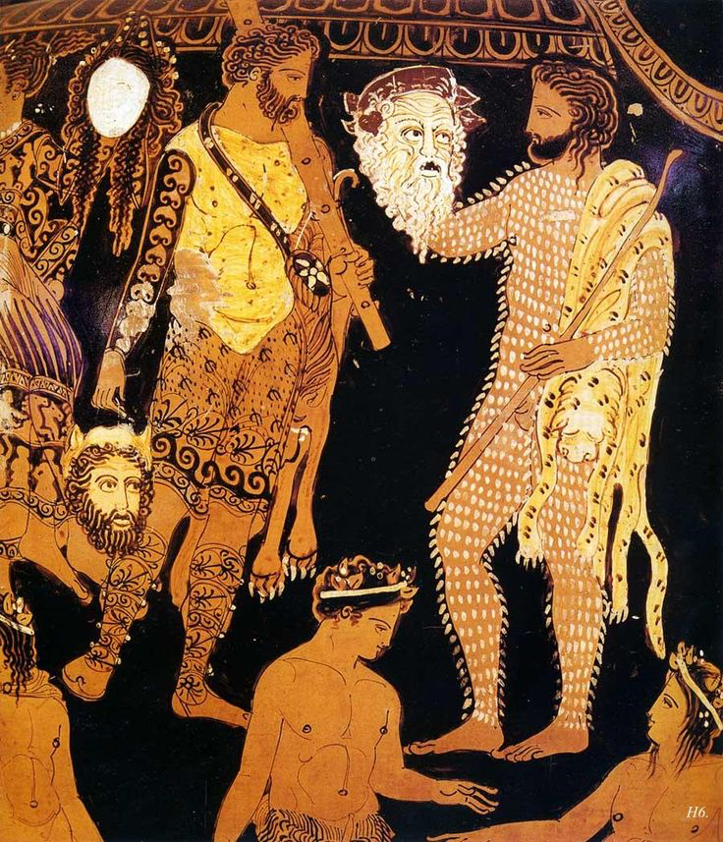
Experience & Empathy
Experience:
(the process of getting) knowledge or skill that is obtained from doing, seeing, or feeling things, or something that happens which has an effect on you.
Empathy:
the ability to share someone else's feelings or experiences by imagining what it would be like to be in that person's situation.

Slide 9
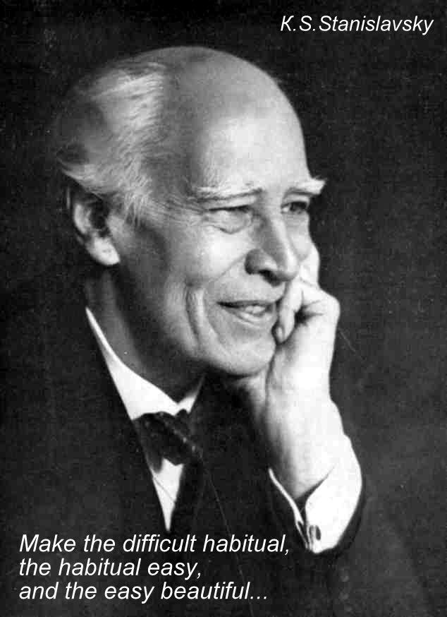
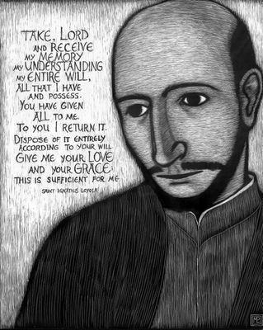
Sensing / Sentir
For it is not knowing much, but realizing and relishing things interiorly, that contents and satisfies the soul. Ignatius Loyola, Spiritual Exercises, Annotations No 2.
In theatre knowledge is feeling (sensing). Konstantin Stanislavski, An Actor’s Work, Preface.
Notes:
http://www.beliefnet.com/entertainment/movies/2003/10/acting-is-a-form-of-prayer.aspx

Slide 10
Circle of public solitude
Notes:
Stanislavski: One needs to centred. It is not a question of going out of the centre but of opening up the circle to let others in.
Exercises on centering Walk – freeze, awareness protect personal space.

Slide 11
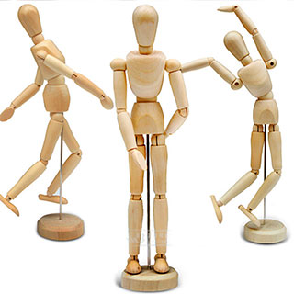
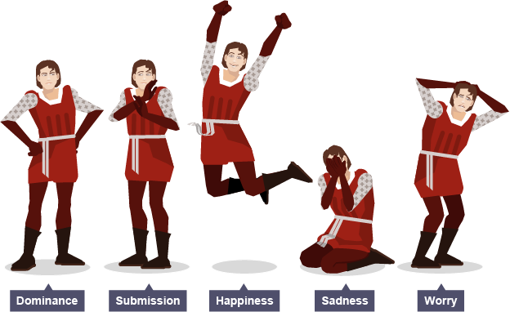
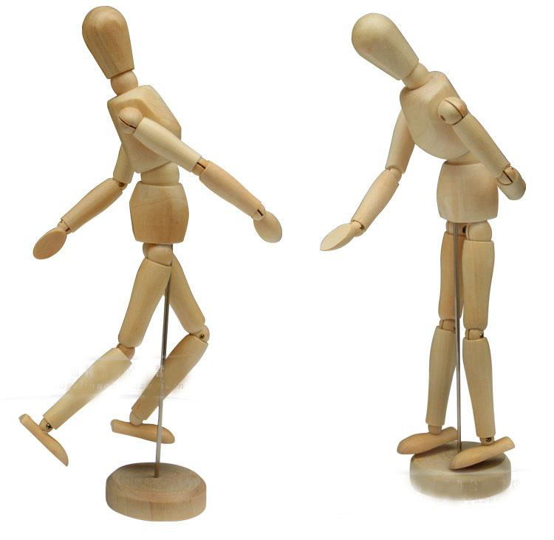
Body language
Body language is communication by movement or position, particularly facial expressions, gestures and the relative positions of a speaker and listener. It may be the message being conveyed or it may add layers of meaning to the spoken words, being referred to as non-verbal communication.
http://www.bbc.co.uk/education/subjects/zbckjxs
Notes:
Emotion : anger, sadness, disappointment, disbelief/surprise, 3 different images
Doing not showing

Slide 12
The revelatory power of the imagination
[…] a composition, seeing the place. It will be here to see with the sight of the imagination the …
I making myself a poor creature and a wretch of an unworthy slave, looking at them and serving them in their needs, with all possible respect and reverence, as if I found myself present…
Notes:
Role play – the magic if

Slide 13
Using the 5 senses
Prayer. After the Preparatory Prayer and the three Preludes, it is helpful to pass the five senses of the imagination through the first and second Contemplation, in the following way:
First Point. The first Point is to see the persons with the sight of the imagination, meditating and contemplating in particular the details about them and drawing some profit from the sight.
Second Point. The second, to hear with the hearing what they are, or might be, talking about and, reflecting on oneself, to draw some profit from it.
Third Point. The third, to smell and to taste with the smell and the taste the infinite fragrance and sweetness of the Divinity, of the soul, and of its virtues, and of all, according to the person who is being contemplated; reflecting on oneself and drawing profit from it.
Fourth Point. The fourth, to touch with the touch, as for instance, to embrace and kiss the places where such persons put their feet and sit, always seeing to my drawing profit from it.

Slide 14
Still Image
Here are some ways to create a still image:
one person acts as a sculptor and creates images by positioning individuals in the group in relation to one another to create a still image.
a group can create an image one by one, to show a large group situation, e.g. after a road accident.
a piece of action can be stopped at a particular moment, to allow an audience to appreciate what is happening.
Just like a photograph, a still image can be examined closely, and the audience can note body language, facial expressions or proxemics (the distance between characters) to give clues as to the situation or the people within the situation at that moment.
http://www.bbc.co.uk/education/subjects/zbckjxs

Slide 15
Biography
Genevieve Camilleri (CLC Malta)
Teacher of Drama and English and a member of the Ignatian Formation Team at St Aloysius College, B’Kara, Malta.
First degree in Theatre Studies (University of Malta) and a Masters degree in Religious Studies (University of Malta) focusing on the dialogue between The Spiritual Exercises of Ignatius of Loyola and the art of the actor.
Conducts retreats and workshops on praying with the body, using drama techniques in contemplation and using drama in catechesis.
Contact
Mob no: 00356 79298049
Email: genevievecamilleri26@gmail.com

