Slide 1
World CLC and Youth
Notes:
ABOUT OUR LOGO
We did not go too far to find inspiration for the logo of the Christian Life Community (CLC). Countless books have been written about the Salvation history of CLC and its beginning in year 1563. From that came the Marian Congregations and its symbol (shown on the top right), having the “P” over the “X” (for the Greek Christus) and the inserted “M” illustrates that the Congregations were put under the patronage of Mary, the mother of Jesus. The blue curved line illustrates a movement forward to one World Community in 1967; hence the globe. From this new beginning came a new name: Communauté de Vie Chrétienne (CVX) in French; Comunidad de Vida Cristiana (CVX) in Spanish; Christian Life Community (CLC) in English.
(Progressio copyright pages)

Slide 2
1563
Marian Congregations
Notes:
A pilgrimage
Jean Leunis and the Marian Congregations

Slide 3
1967
World Federation of
Christian Life Communities
Notes:
Renewal in 67-
Growth into a Body
50 Years Hence>>>

Slide 4
2017
2018
Buenos Aires World Assembly
You are here
Notes:
This year… (ala teaser trailer)

Slide 5
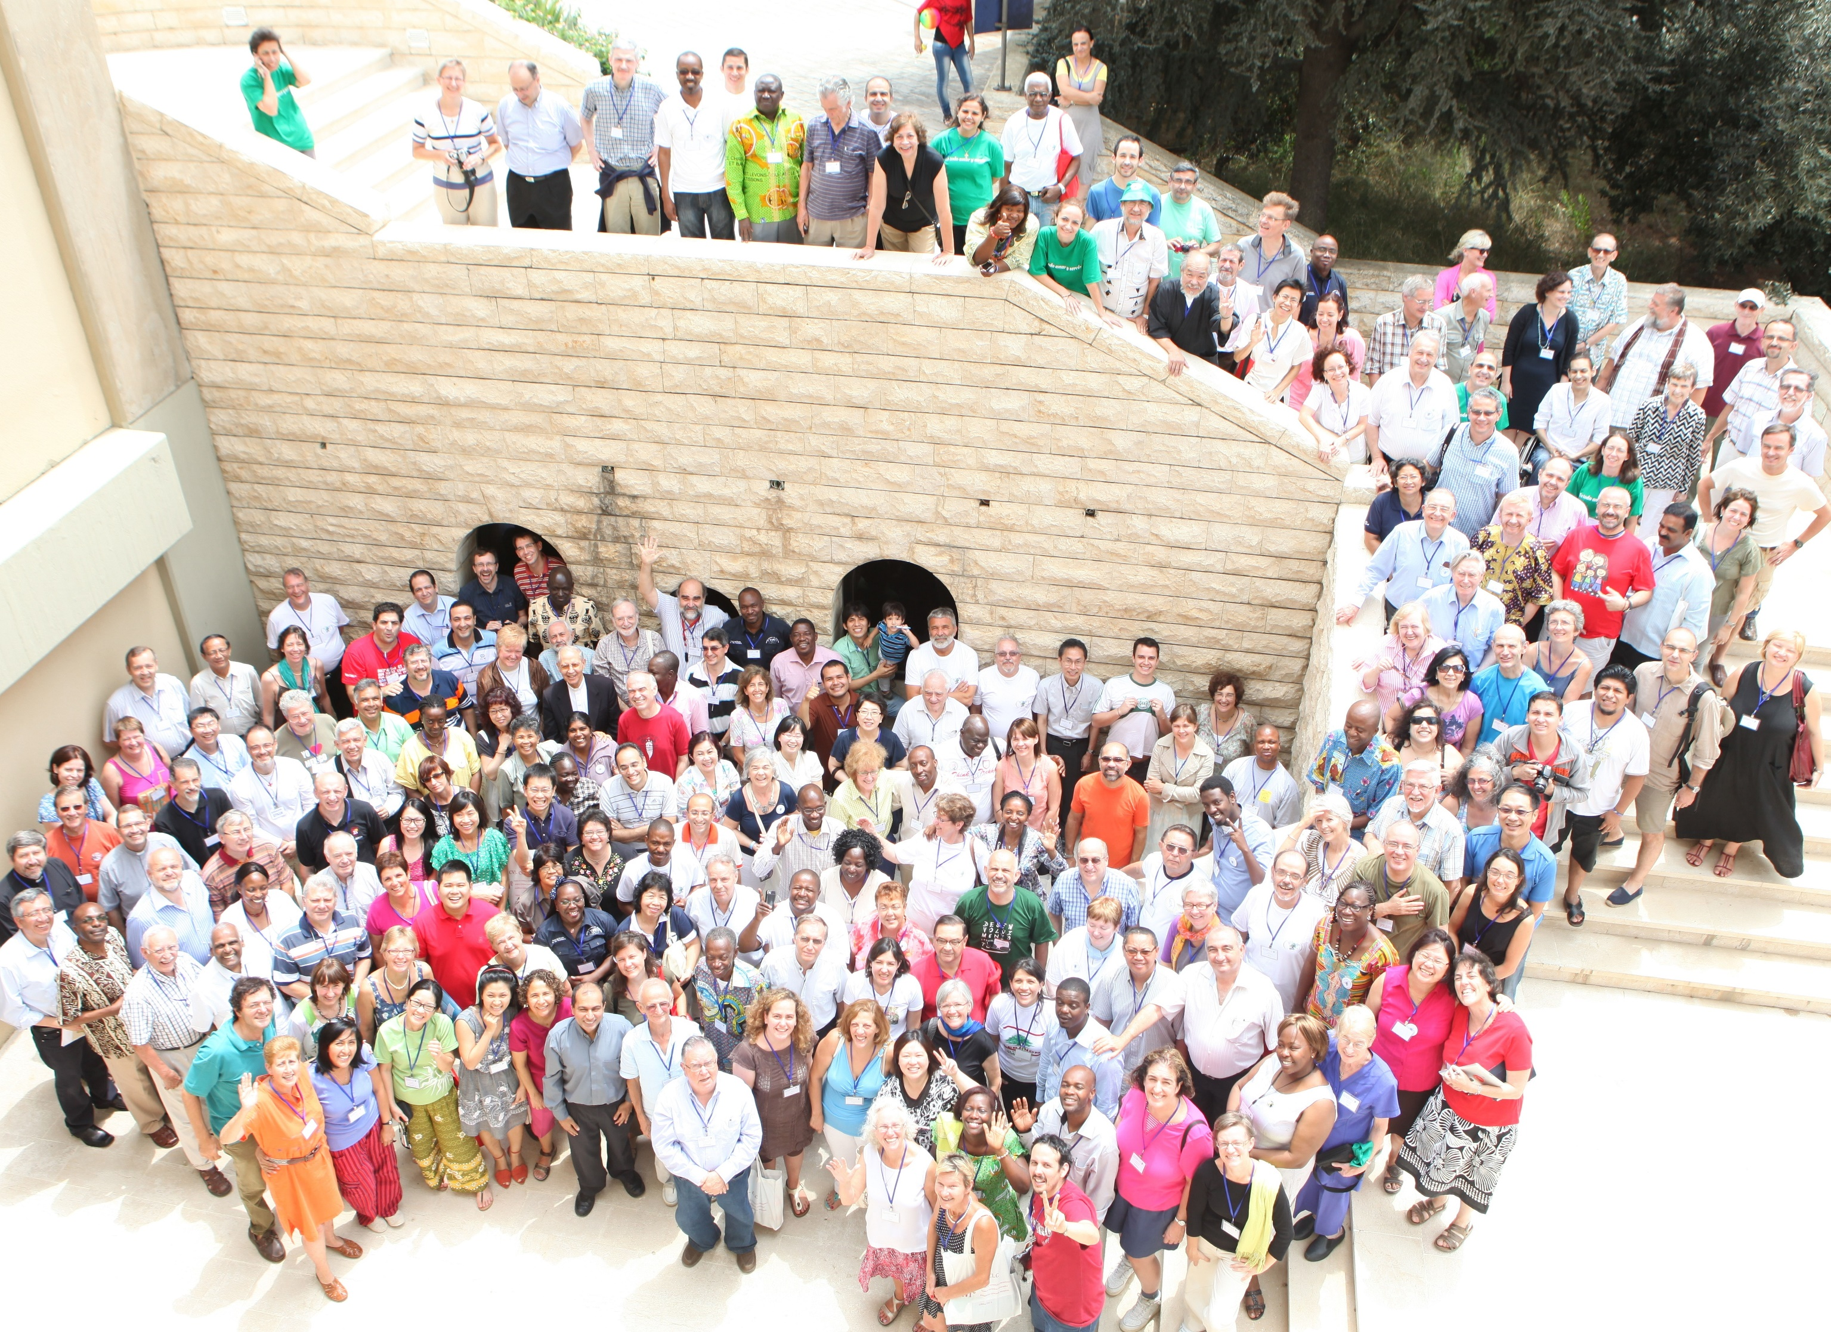
64 Communities
24,000 members worldwide
6 World Regions
+ 10++ Observer and Emerging Communities

Slide 6
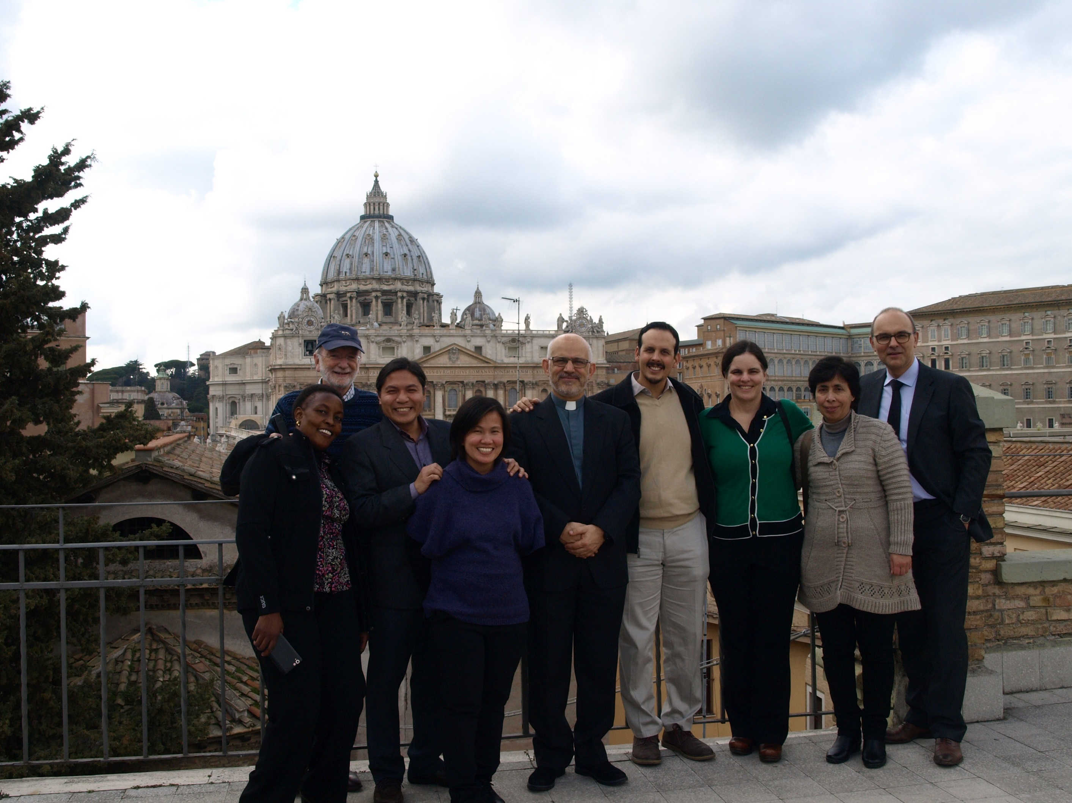
Holding the space for the Spirit of the World Assembly
Co-Discerners
World Executive Council
Notes:
http://cvx-clc.net/l-en/exco.php

Slide 7
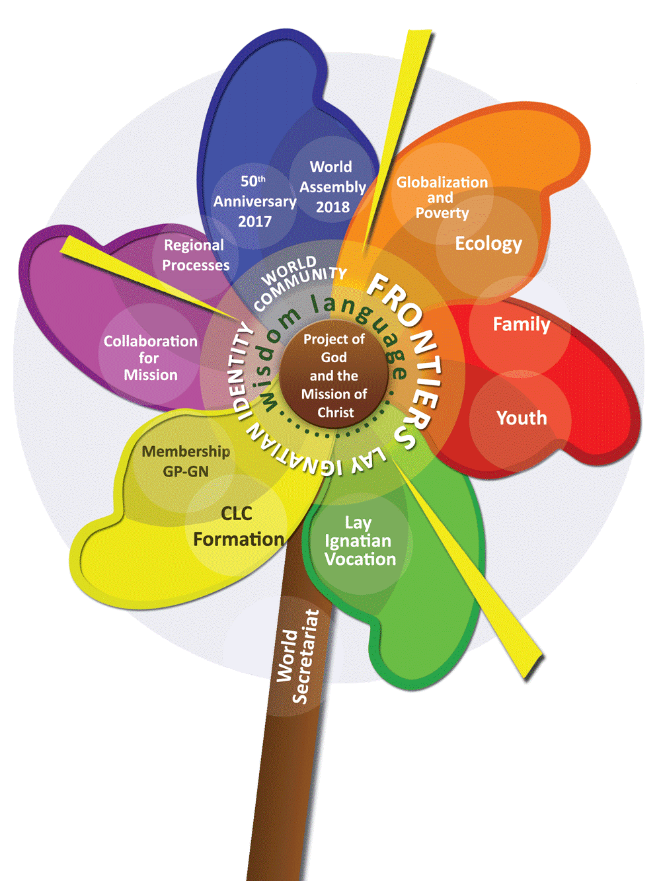
Notes:
http://cvx-clc.net/l-en/projects/Projects_162.pdf

Slide 8
Notes:
14 minute mark estimate, handover to Najat. Beyond that and you’ve talked too much and may have lost audience engagement boooiiiii

Slide 9
The Lebanon Assembly’s sense of calling regarding the youth:
Meaningfully engage with Youth in Community
Develop a sensitivity with apostolic work with the Youth
CLC
outside CLC
Notes:
Youth Commission
For a number of reasons, the delegates to the World Assembly Lebanon 2013 perceived “Youth” as one of the important frontiers to be addressed. These included a concern about the lack of young people in our community and a recognition that our CLC way of life (including Ignatian spirituality) offers young people a way to find meaning, mission and an authentic encounter with Christ in their personal life journeys. Assembly delegates were eager to pass on the fire of the CLC vocation to ever more young people. In doing so, they saw that we are called to:
meaningfully engage youth in the community, and
develop a sensitivity in our apostolic work with youth.
It has also been recommended that W-ExCo set up a commission on Youth.

Slide 10
The Lebanon Assembly’s concrete recommendation:
Youth Commission
Notes:
It has also been recommended that W-ExCo set up a commission on Youth.
The W-ExCo has responded to that request. A Youth Commission was created, formed of ExCo members and members from different countries. The members of this commission have met virtually and exchanged their experiences and opinions, as well as some materials .

Slide 11
Youth—heirs of the past, pioneers of the future
extracts from Projects 165
Notes:
Projects is the regular document set by the exco to all national communities:
http://cvx-clc.net/l-en/projects/Projects_165.pdf
Young people are a sign of vitality and life. They are the power of today and the hope of tomorrow. On them rests the future of the Church and the world, and of any institution. But we find that on the one hand, many of our members are over the age of youth, and on the other hand, we would like more youth to know about the richness of the CLC way of life.

Slide 12
… we find that on the one hand, many of our members are over the age of youth, and on the other hand, we would like more youth to know about the richness of the CLC way of life.
Notes:
But we find that on the one hand, many of our members are over the age of youth, and on the other hand, we would like more youth to know about the richness of the CLC way of life.

Slide 13
While we would like to have youth as members, our main focus is to help youth find the right path in life.
Our focus is to help them seek and find God.
In that process, some of them will also discover a vocation to CLC.
Notes:
Following exchanges and discussions, we felt that the most important thing would be to share our CLC Charism and Ignatian spirituality with young people, wherever they are committed in the Church and in society, without necessarily adhering to CLC. While we would like to have youth as members, our main focus is to help youth find the right path in life. Our focus is to help them seek and find God. In that process, some of them will also discover a vocation to CLC.

Slide 14
CLC is a Vocation
“Our Community is made up of Christians: men and women, adults and youth, of all social conditions who want to follow Jesus Christ more closely and work with him for the building of the Kingdom, who have recognized Christian Life Community as their particular vocation within the Church.” (GP4)
“Becoming a member of Christian Life Community presupposes a personal vocation.” (GP10)

Slide 15
Encouraging Vocational Discernment
Children of CLC families
let us welcome children of our members, reserve them a place in our national meetings, so they can grow up in a CLC atmosphere where they can continue their belonging and commitment.
EYM (Eucharistic Youth Movement)
The parishes
Many CLC members have the opportunity to introduce CLC to young parishioners
Many are introduced to Ignatian spirituality thanks to the Jesuits that accompany them. A collaboration with their guides and Jesuits is needed in this area.
Universities
the "university parish" offers students adequate supervision. But at the end of their studies, they do not know where to go. This is where the intervention of CLC would be useful.
Notes:
But we can encourage this vocation by working especially with certain categories of persons:
In all these areas, we can sow, and it is the Lord who will germinate the CLC vocation in the hearts that He chooses to attract in this way. What are we called to do is be visible, and promote an awareness of CLC as an option. We must also have the resources and availability to welcome and support those who become attracted and who wish to discern about this specific lay vocation in the Church.

Slide 16
Keeping our young members
Serve
Entrust with responsibility
Model – love, humililty, generosity, patience, forgiveness
Notes:
Needs of youth and achievements
But how do we keep our young members? Obviously, by serving them and by entrusting them with responsibilities. Do not forget that young people need adults who are for them models of love, humility, generosity, patience, and forgiveness.

Slide 17
Attending to Young Adult CLCs
(20s-30s)
Let us journey with them in the phase of life where they seek to discern commitments as they deepen their understanding of vocation, through work, and starting families
Notes:
Needs of youth and achievements
We might also be attentive to our own CLC young adults - members who start out life after school/education (20s-30s). Let us journey with them in the phase of life where they seek to discern commitments as they deepen their understanding of vocation, through work, and starting families.

Slide 18
World Youth Day Krakow Poland

Slide 19
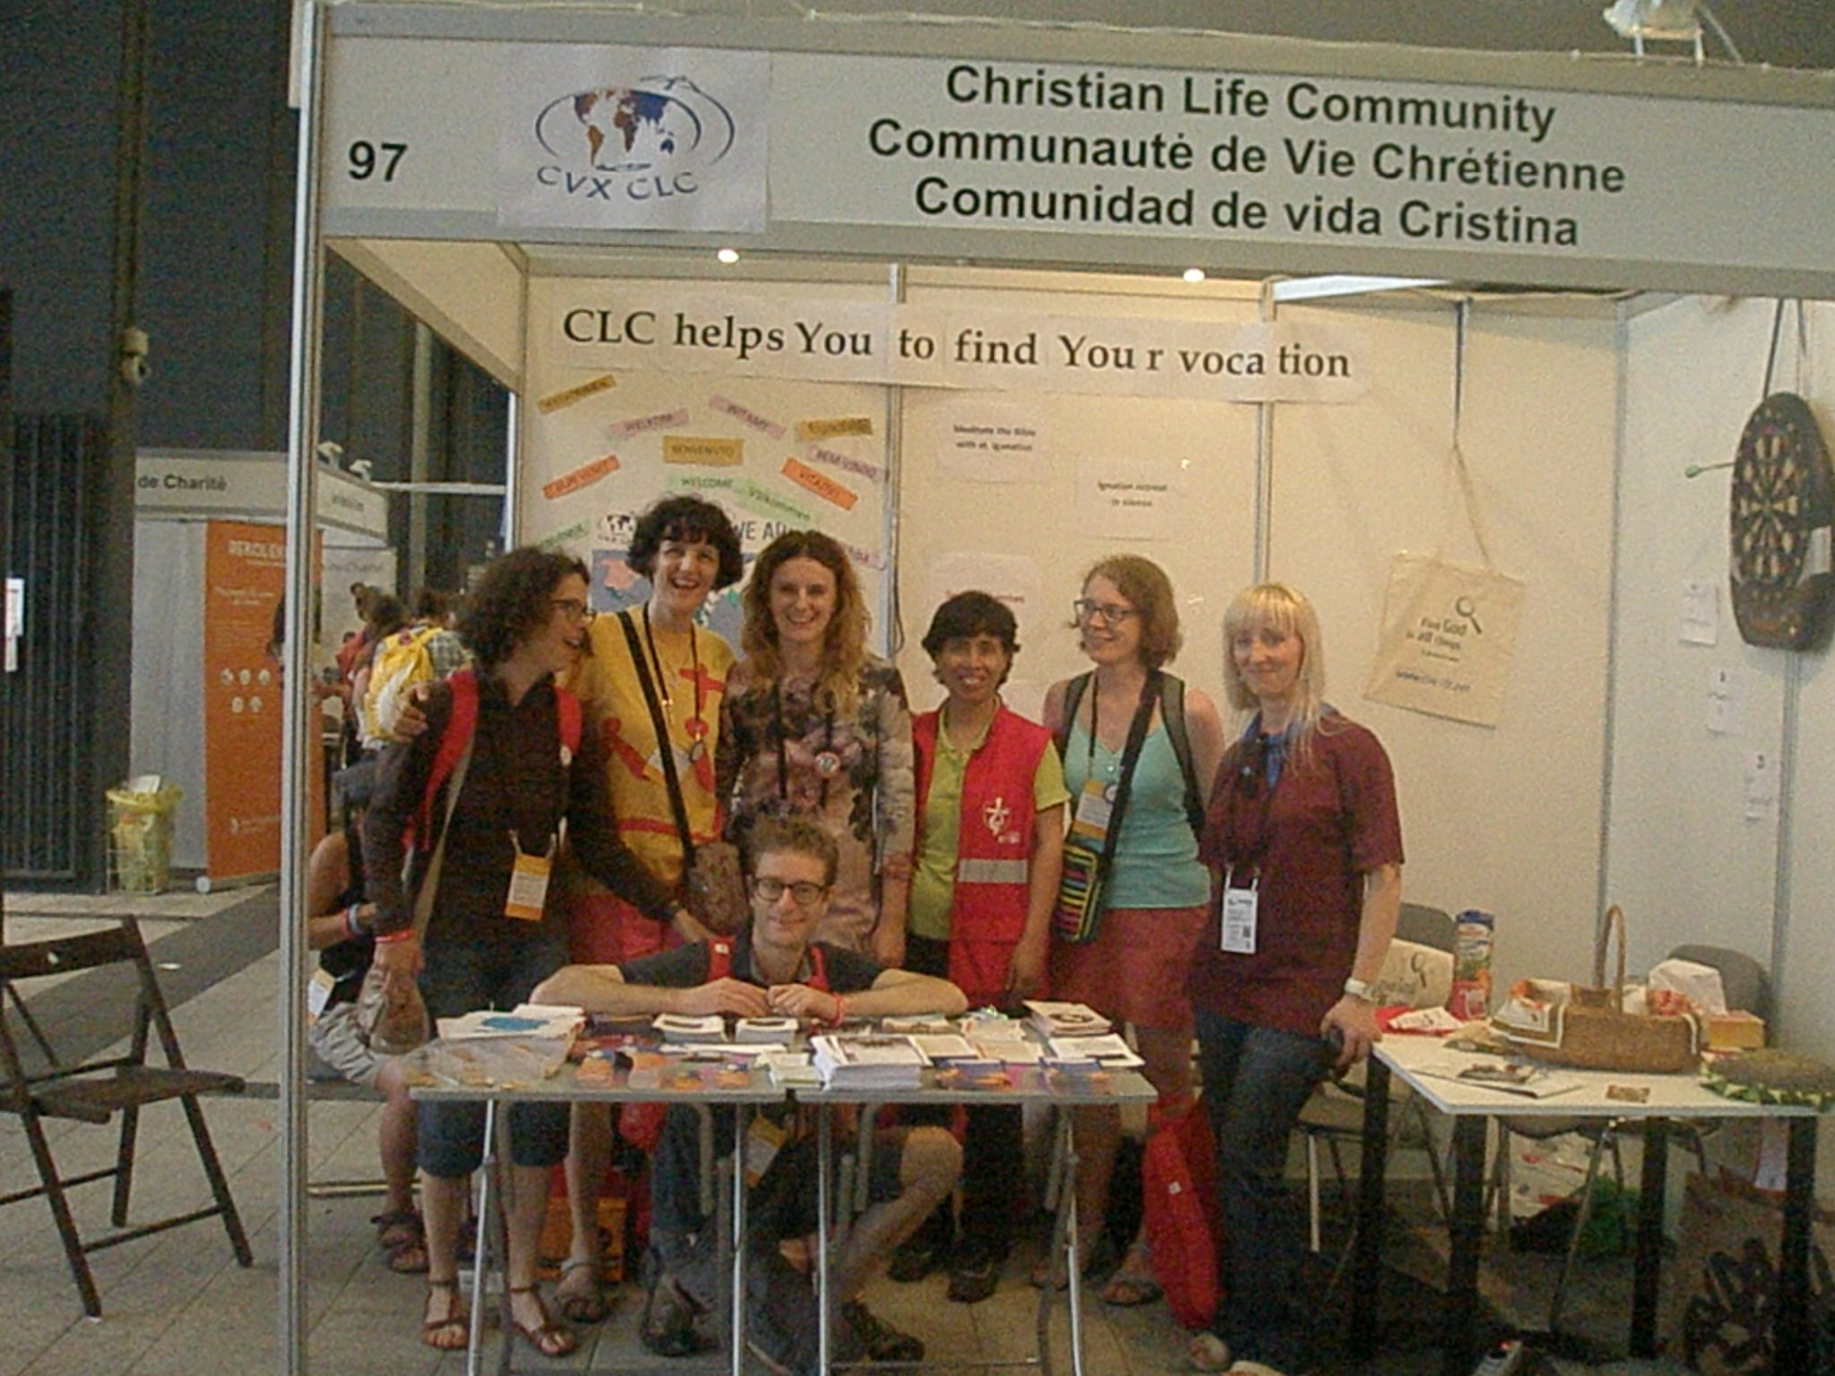

Slide 20
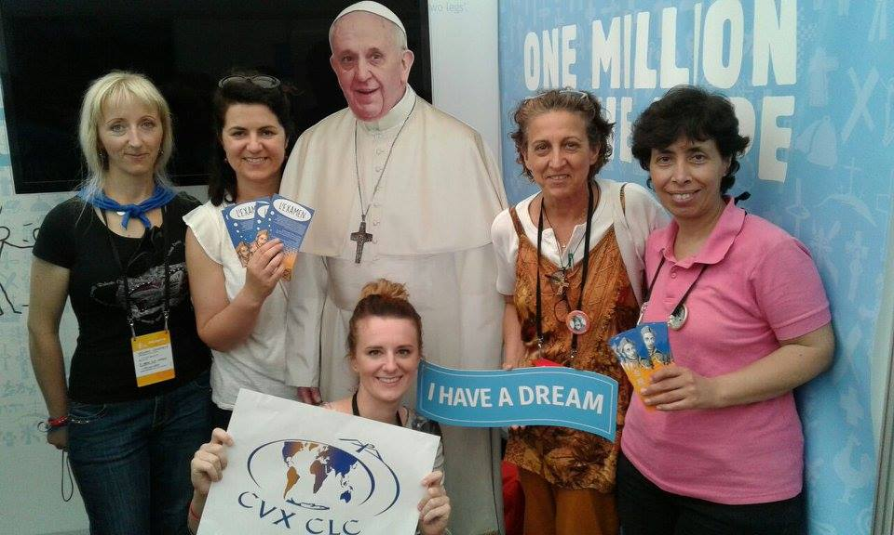

Slide 21
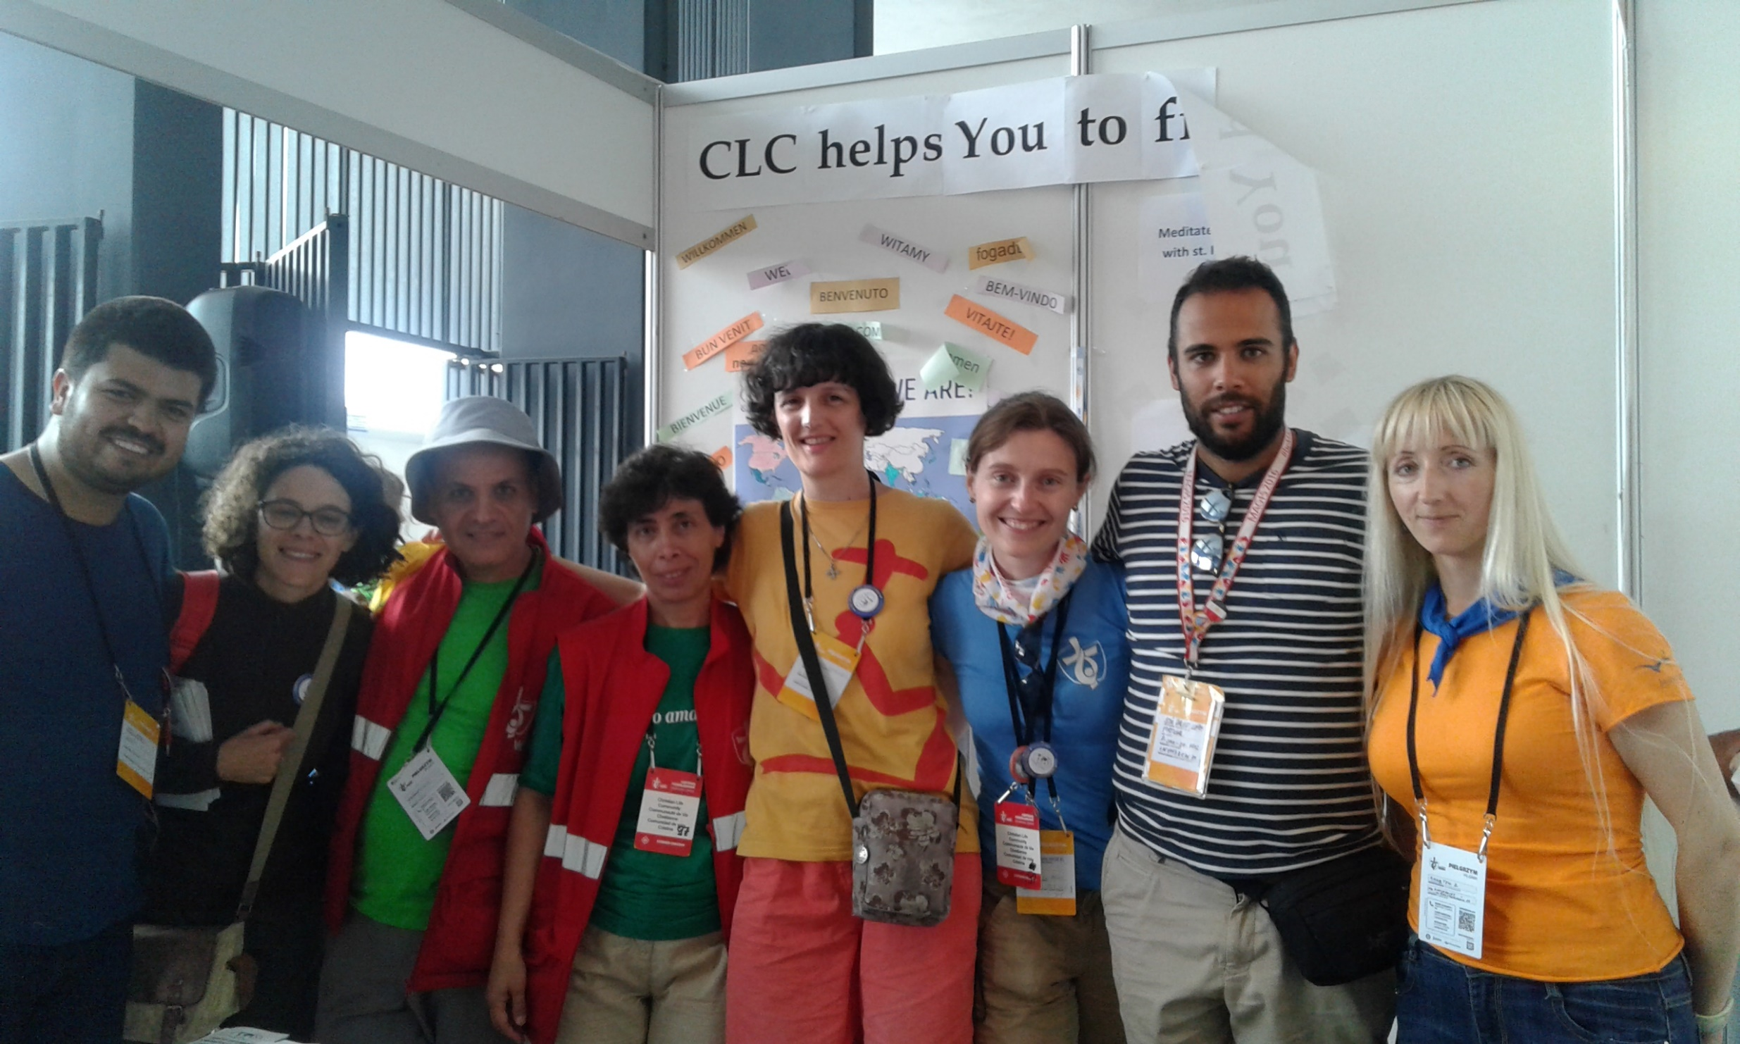

Slide 22
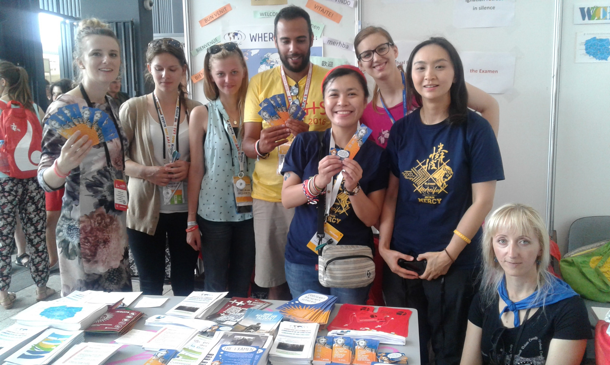

Slide 23
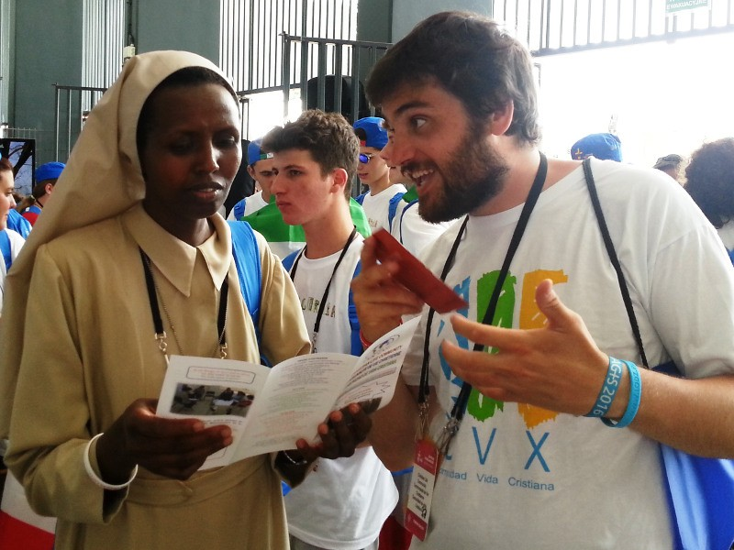

Slide 24
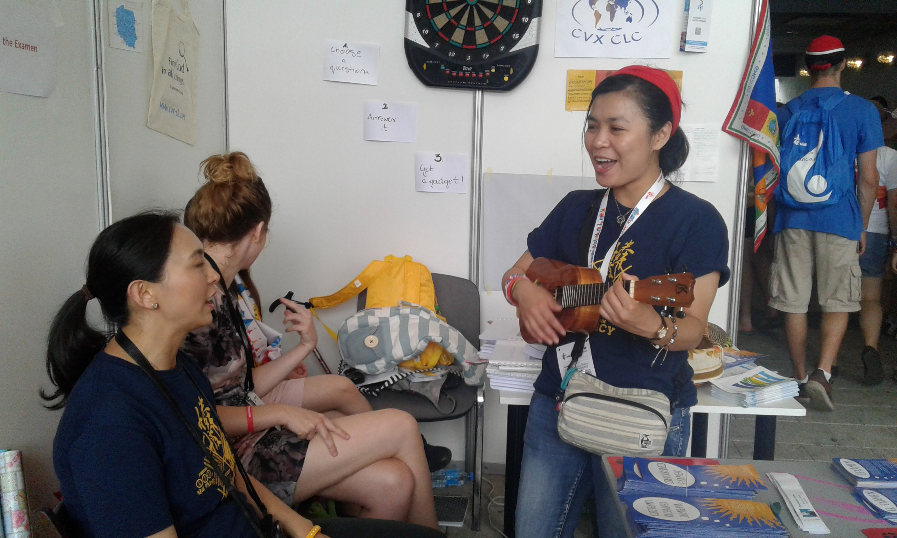

Slide 25
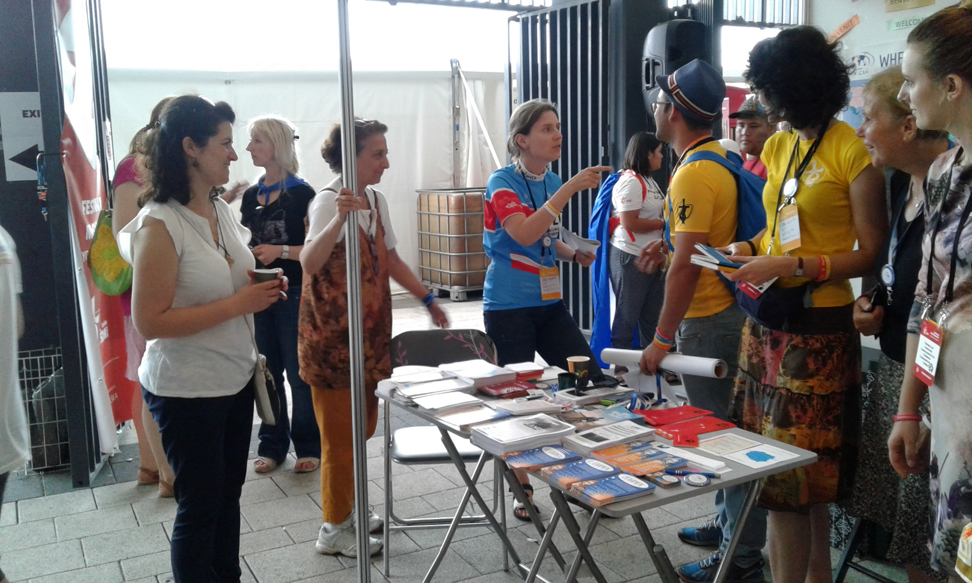

Slide 26
Asian Youth Day
Indonesia

Slide 27
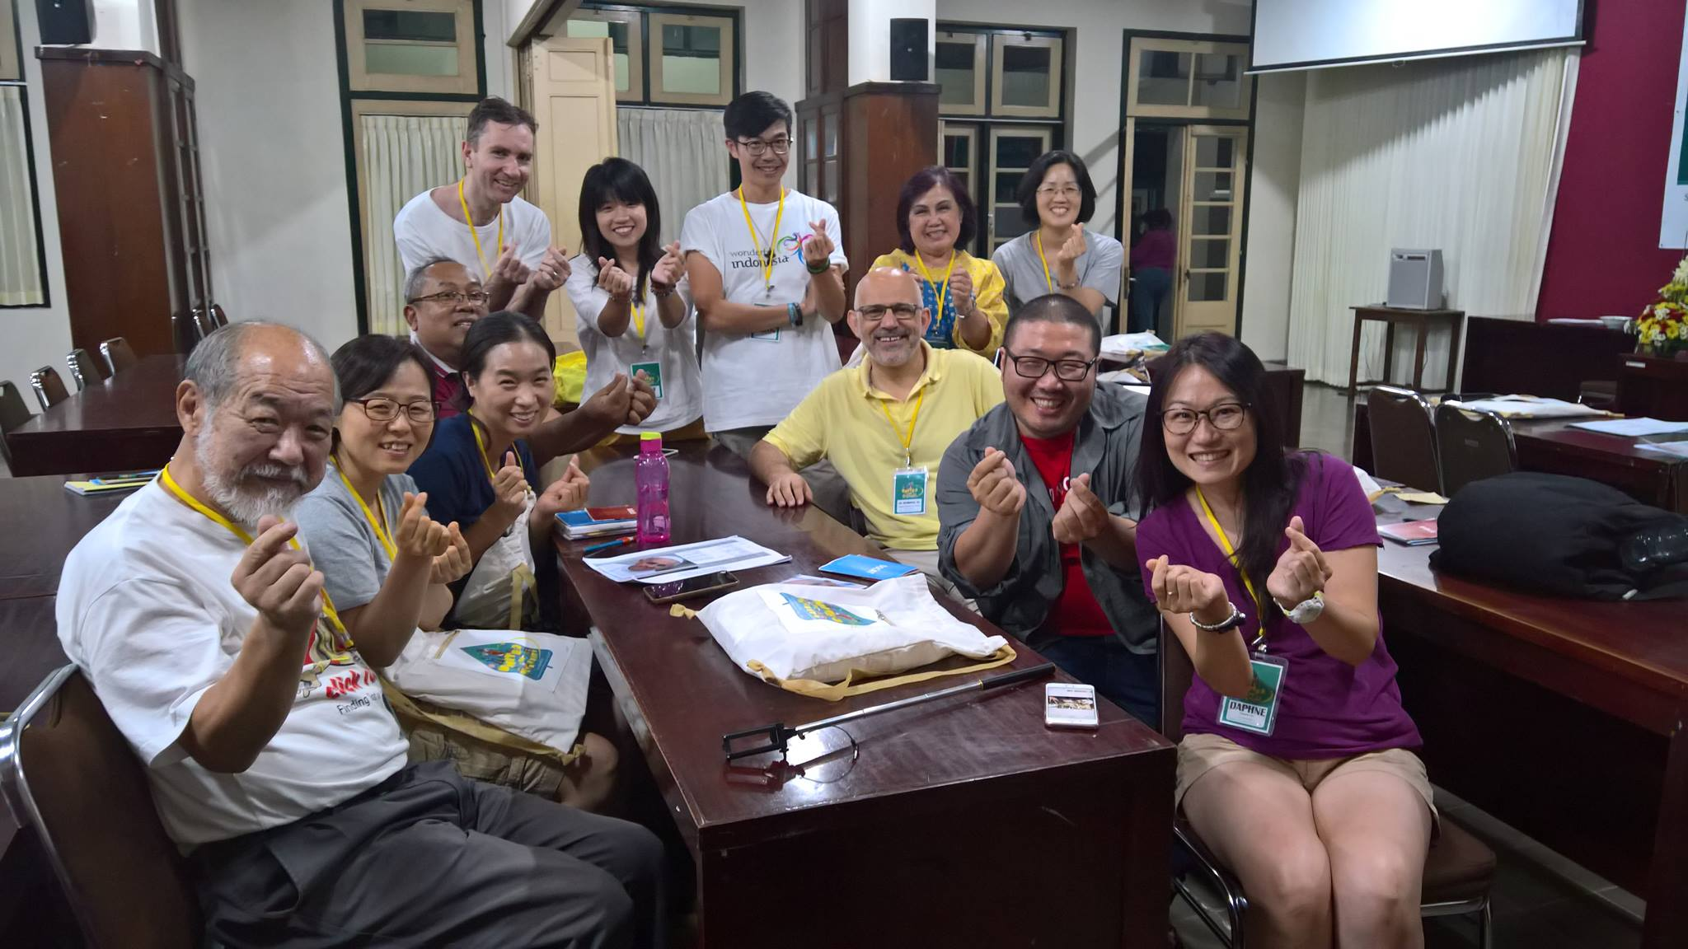

Slide 28
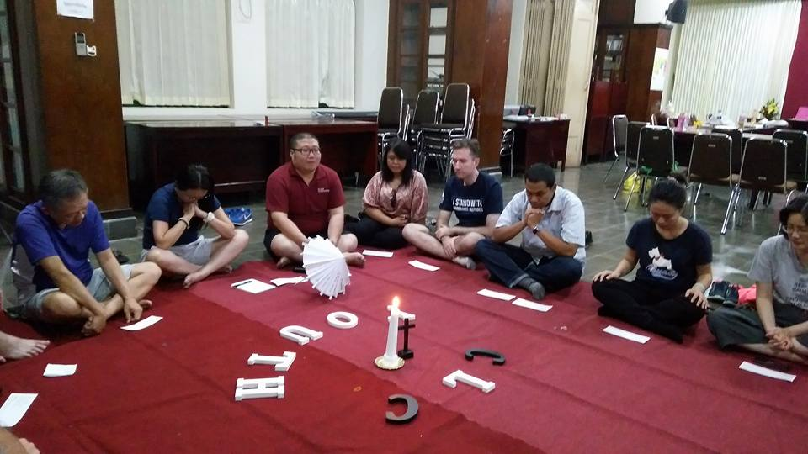

Slide 29
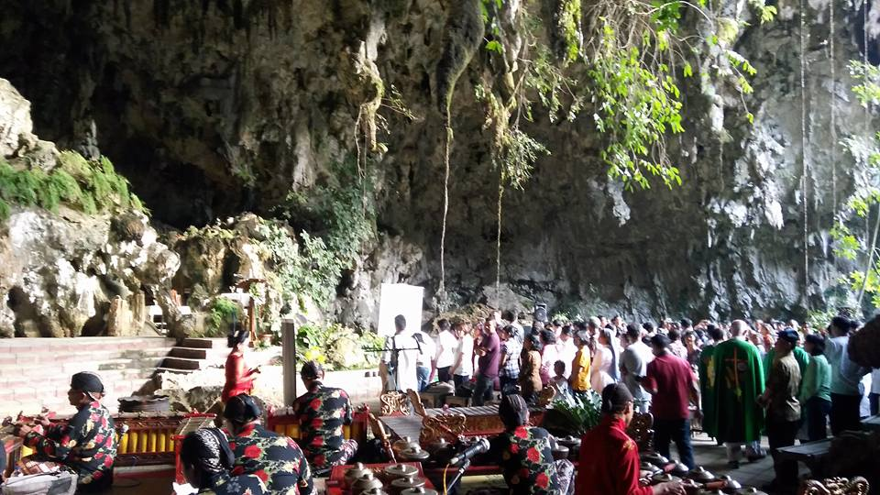

Slide 30
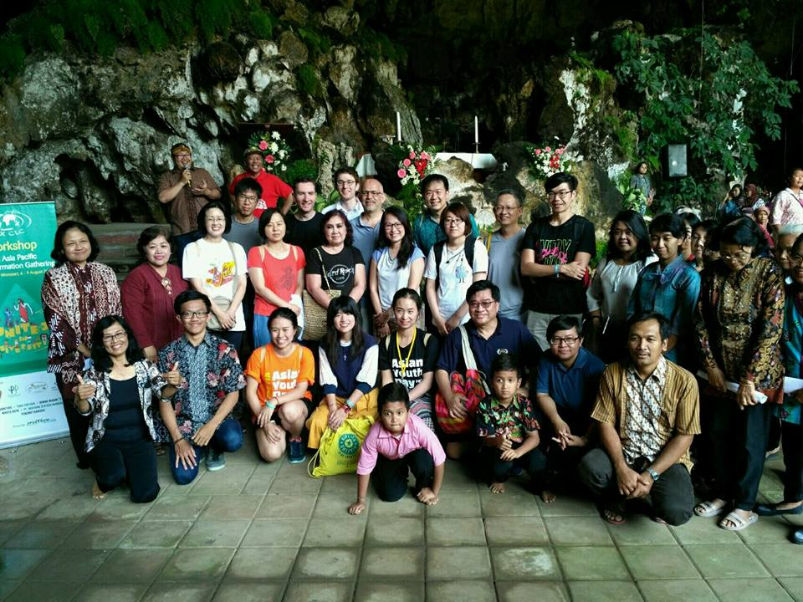

Slide 31
…our role is not attracting young people just for the sake of CLC, but transmitting the treasure that we have received and are enjoying so much.
It is, at the same time, an urge of overflowing joy and a real responsibility toward our society,
i.e. facilitating an encounter with proven tools of discernment for the new generation, the one that will understand the world of tomorrow better than we could do, and fostering the transmission of a spirituality that can accompany the struggles of a rapidly changing world.

Slide 32
Moving Forward: Connecting with the Church
The General Synod 2018

Slide 33
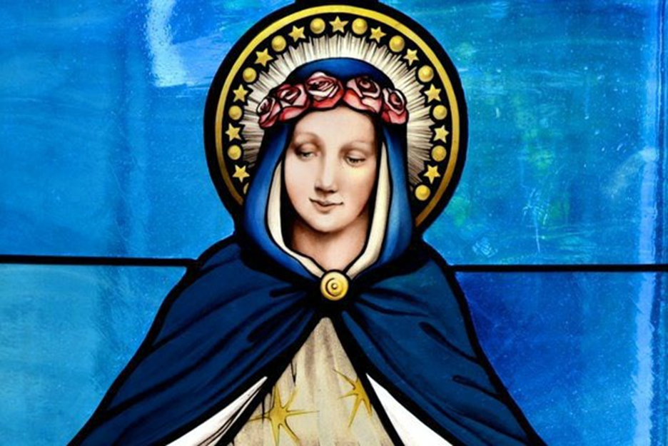
Mary, the young woman of Nazareth, who in every stage of her existence accepted the Word, and preserve it, pondering it in her heart (cf. Lk 2:19) was the first to fulfill this journey.
Notes:
Dedication to Mary and John

Slide 34
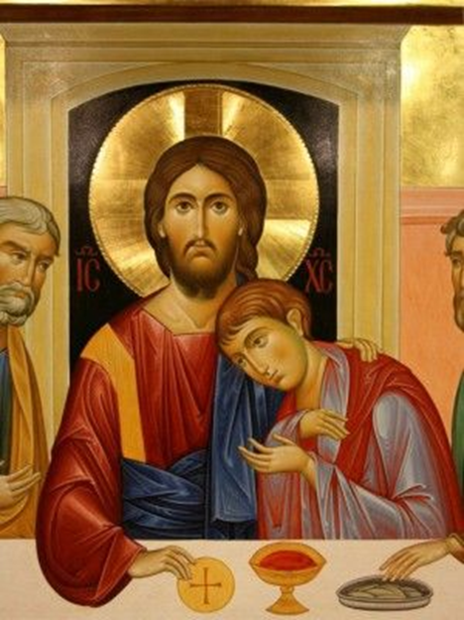
In the traditional reading of the Fourth Gospel, John is both an example of a young person who chooses to follow Jesus and “the disciple Jesus loved” (Jn 13:23; 19:26; 21:7).
Notes:
Dedication to Mary and John

Slide 35
3 Parts of the Preparatory Document
Young People in Today’s World
“the result of research in the social sphere” and “of studies conducted at the international level
Discernment
Recognizing
Interpreting
Pastoral Activity
Going out
Choosing
Seeing
Calling

Slide 36
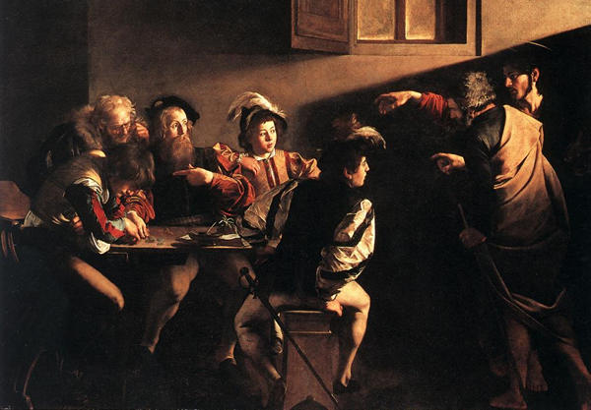
An example of vocation: The calling of St Matthew
by Cavaraggio
Notes:
“Youth is not a time of life; it is a state of mind; it is a matter of the will, a quality of the imagination, a vigour of the emotions, a temperamental predominance of courage over timidity, of the appetite, the love of adventure over the love of ease... So long as it receives messages of beauty, hope, cheer, grandeur, courage, and power from the earth, from men and from the Infinite—so long are you young”.
--Samuel Ullman
Let us be a young Community forever!

Slide 37
Moving Forward:
The General Synod 2018
Notes:
“Youth is not a time of life; it is a state of mind; it is a matter of the will, a quality of the imagination, a vigour of the emotions, a temperamental predominance of courage over timidity, of the appetite, the love of adventure over the love of ease... So long as it receives messages of beauty, hope, cheer, grandeur, courage, and power from the earth, from men and from the Infinite—so long are you young”.
--Samuel Ullman
Let us be a young Community forever!

Slide 38
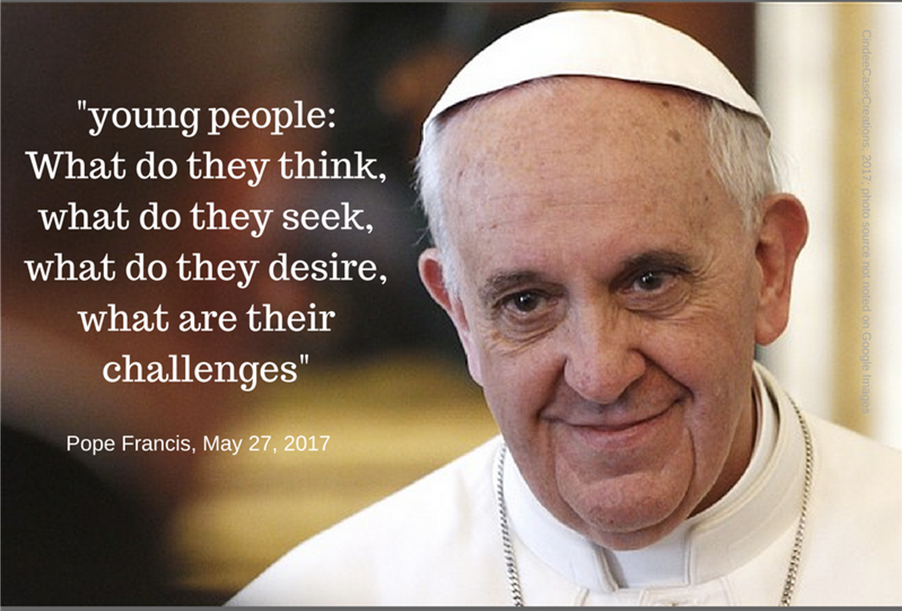
Moving Forward:

Slide 39
http://youth.synod2018.va
Answers will have to be sent to the General Secretariat by 30 November 2017

Slide 40
Moving Forward: Connecting to the World Community
Resources on the Web
Website
Facebook
cvx-clc.net
@CVXCLC

Slide 41
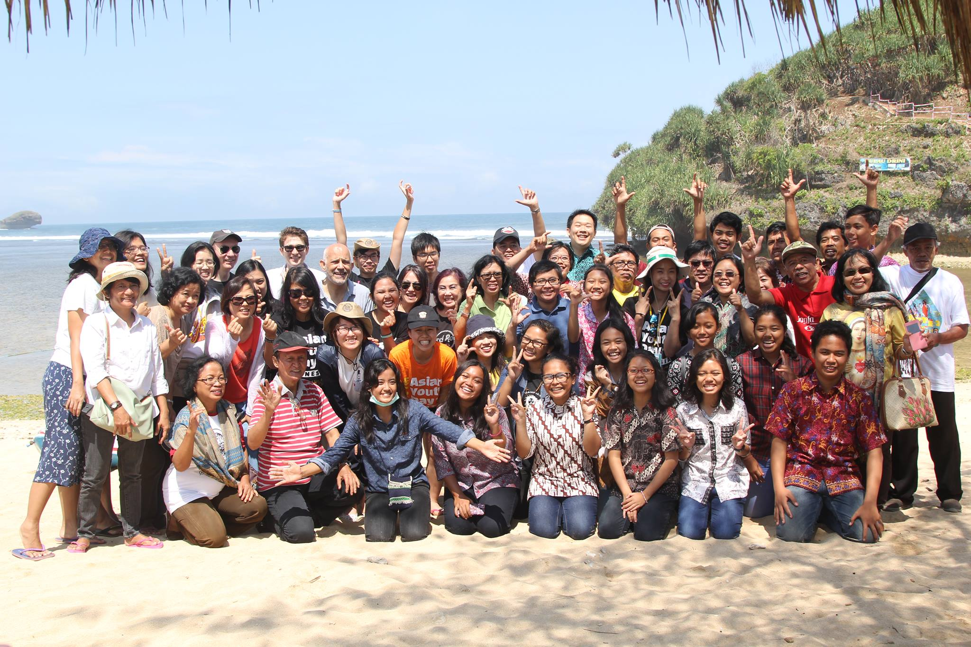
Notes:
“youth” activities in CLC – wide age range (WYD, AYD, Malta). Not all of us are between 16 and 29
BUT…
“Youth is not a time of life; it is a state of mind; it is a matter of the will, a quality of the imagination, a vigour of the emotions, a temperamental predominance of courage over timidity, of the appetite, the love of adventure over the love of ease... So long as it receives messages of beauty, hope, cheer, grandeur, courage, and power from the earth, from men and from the Infinite—so long are you young”.
--Samuel Ullman
Let us be a young Community forever!

