Slide 1
Echappée à la Moselle

Slide 2
A joint-venture of CLC & Caritas
Spending 3 x 5 holidays with young refugees
(non accompanied minors)
Welcomed by a group of young international volunteers
Guided by Agnes Rausch/CLC and Paul Galles/Young Caritas
Together as tourists at Luxemburg riverside

Slide 3
Searching for and preparation of volunteers
Contact with CLC- Egypt and CLC-France;
invitation flyer on CLC-Europe website
Invitation letters and hurdle jumping for visa request
Skype talks with young interested
Whatsapp contacts

Slide 4
Result
Maria and Sarah, students from Egypt
Geneviève, student from Paris
Daniele from Italy, young professional in Luxemburg
Nicolas from France, young professional and CVX-Lu member
Daniel from Luxemburg, studying in UK
Farid from Afghanistan, recognized refugee in Luxemburg

Slide 5
formation day before the start

Slide 6
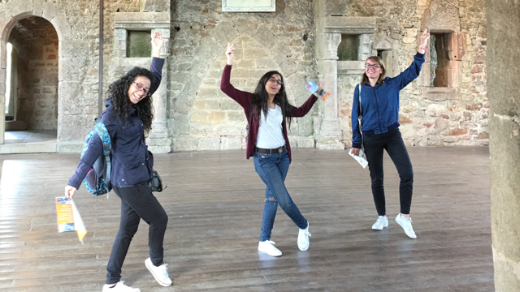
Full time Volunteers
Geneviève, Maria, Sarah

Slide 7
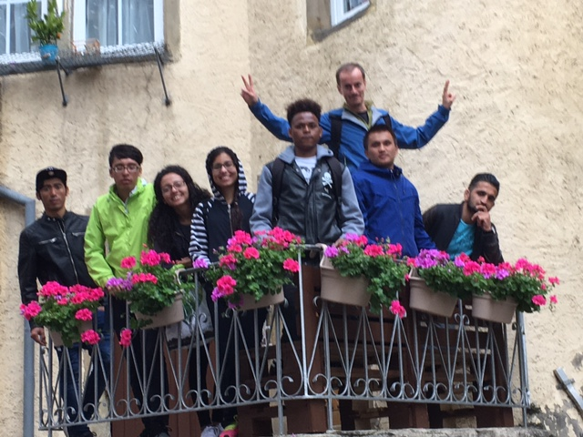
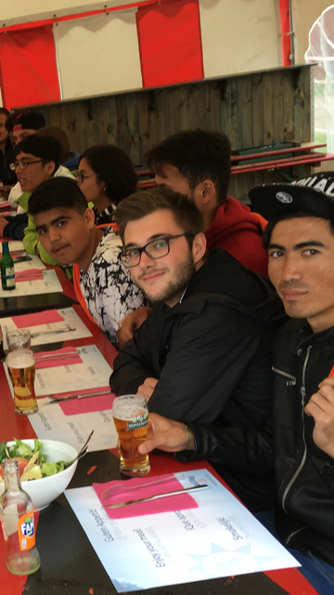
team 1: + Nicolas et Daniel

Slide 8
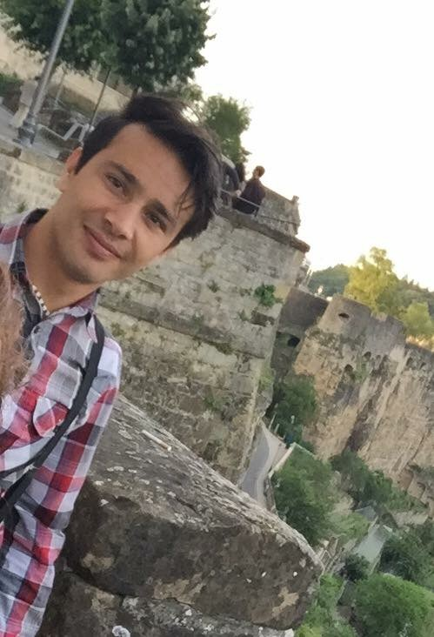
team 2: + Farid et Daniele

Slide 9
Unaccompanied minors from 3 refugee camps
group
Ali, Aboli, Fared, Javid, Mehdi, Nabi, Rahmad, Saboor, Seda from Afghanistan; Agran, Albin, Alberto from Albania; Karim from Guinea.
2. group
Ali, Jamal, Obaid, Saba, Wahid, Zaki from Afghanistan; Hamzah from Algeria, Hassan from Morocco, Murthada from Irak, Amir from Eritrea, Boubacar, Daouda from Guinea, Ossam from Somalia.
3. group
Bekam, Emanuel, Danijel, Fabio from Albania; Arif, Aziz, Bashir, Moheb, Reza, from Afghanistan; Amadou from Senegal.

Slide 10
Together we are strong
A serving and a learning experience for the volunteers
A community experience for all
A faith experience for the volunteers, mainly by the daily review of the day, commmon prayer time and final evaluation
A healing experience for the youngsters, separated from their family

Slide 11
Through importance given to
commmon meals,
(on arrical meals were prepared by CLC-members)
variety of outdoor and indoor games
Cultural visits and sport activities
Sharing confidences and resolving conflicts
Singing, laughing and joking
Cooking, cleaning and washing

Slide 12
Biking , the favourite

Slide 15
Barbecue

Slide 16
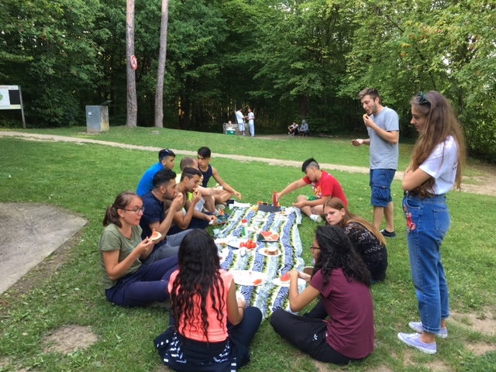

Slide 17
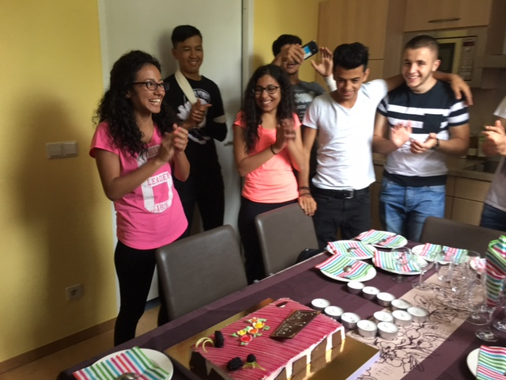
Birthday celebrating

Slide 18
Marie-Astrid boat trip

Slide 19
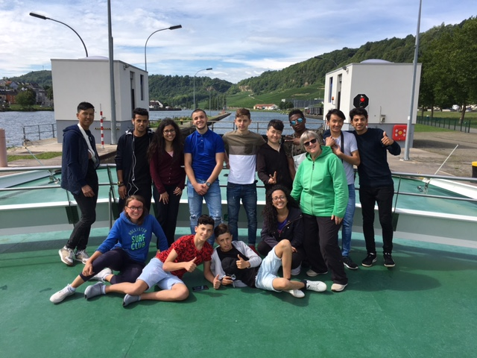

Slide 20
Butterfly garden

Slide 21
FOOTBALL

Slide 22
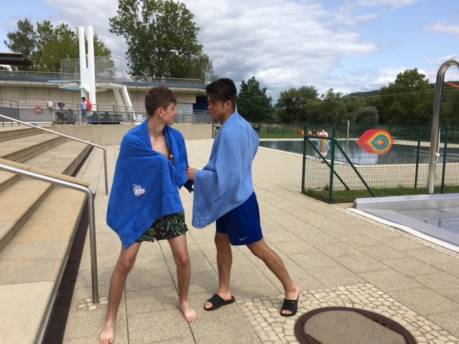
Swimming

Slide 23
Outdoor games

Slide 24
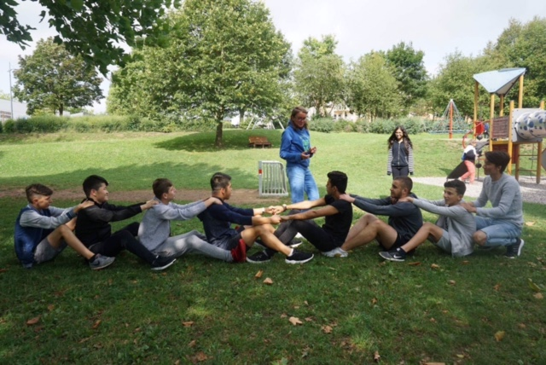

Slide 25
Indoor games

Slide 26
Sharing time

Slide 27
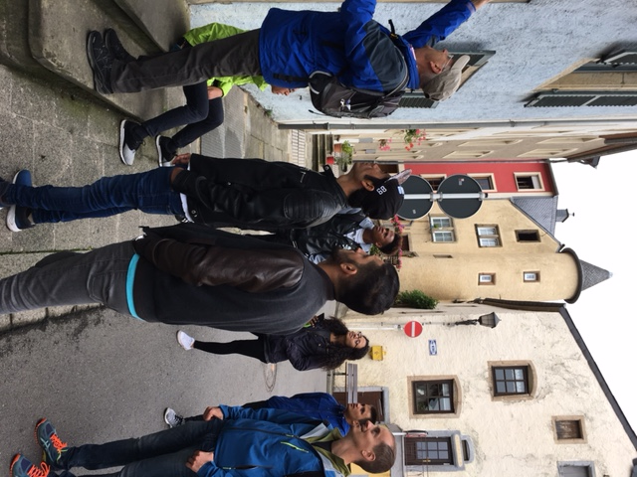
City trip

Slide 28
Enjoying nature

Slide 29
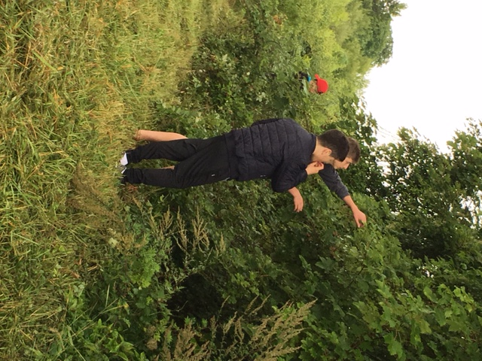
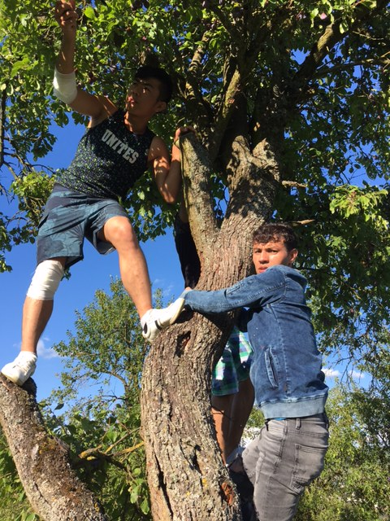

Slide 30
Enjoying friendship

Slide 31
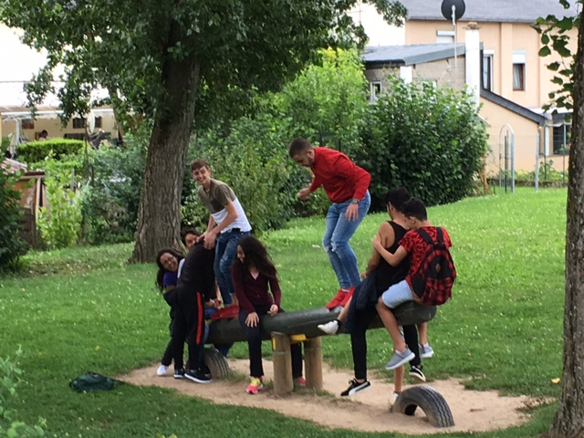

Slide 32
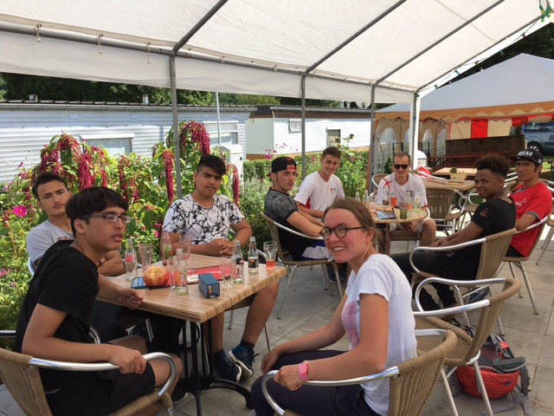

Slide 33
Last dinner of 1. group

Slide 34
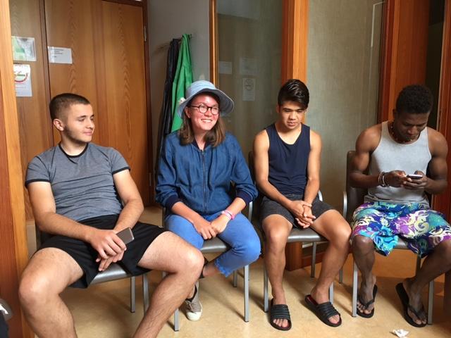
Evaluation time of 3. group

Slide 35
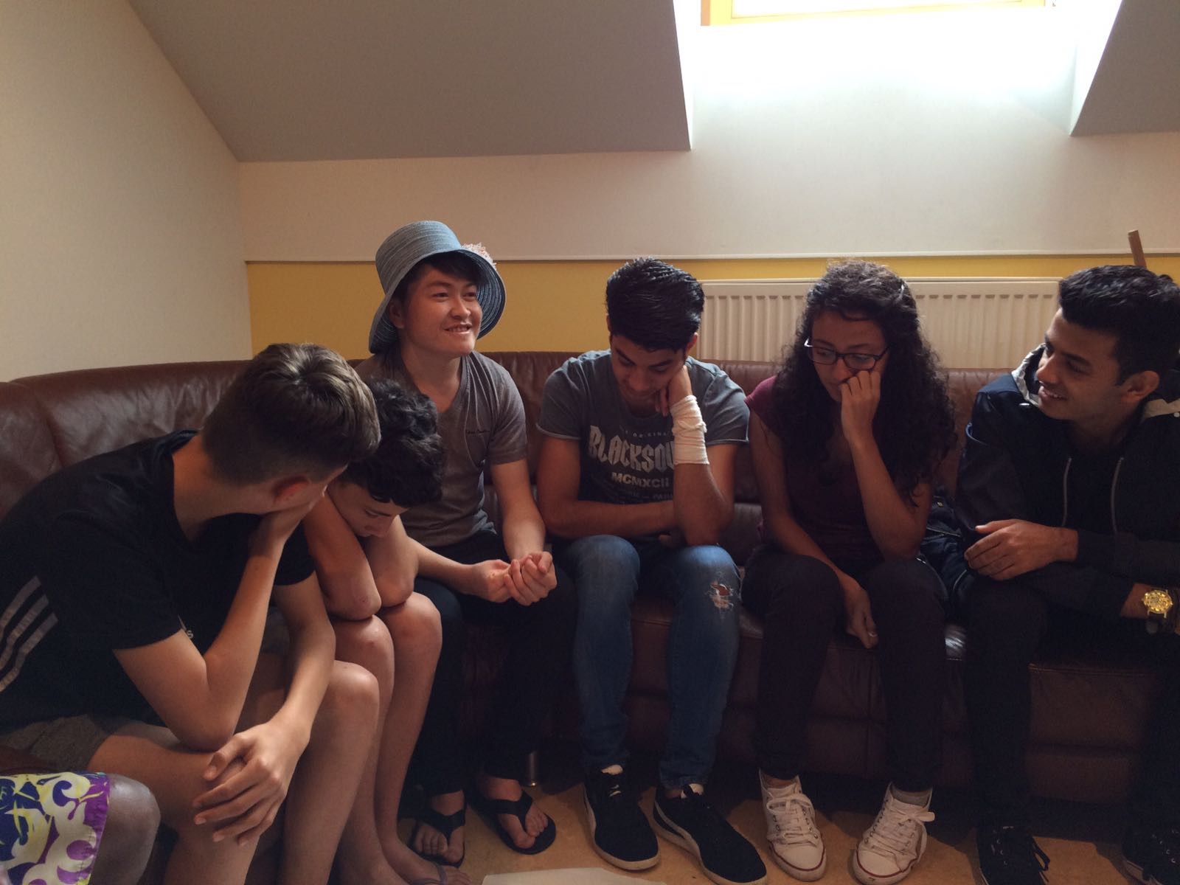

Slide 36
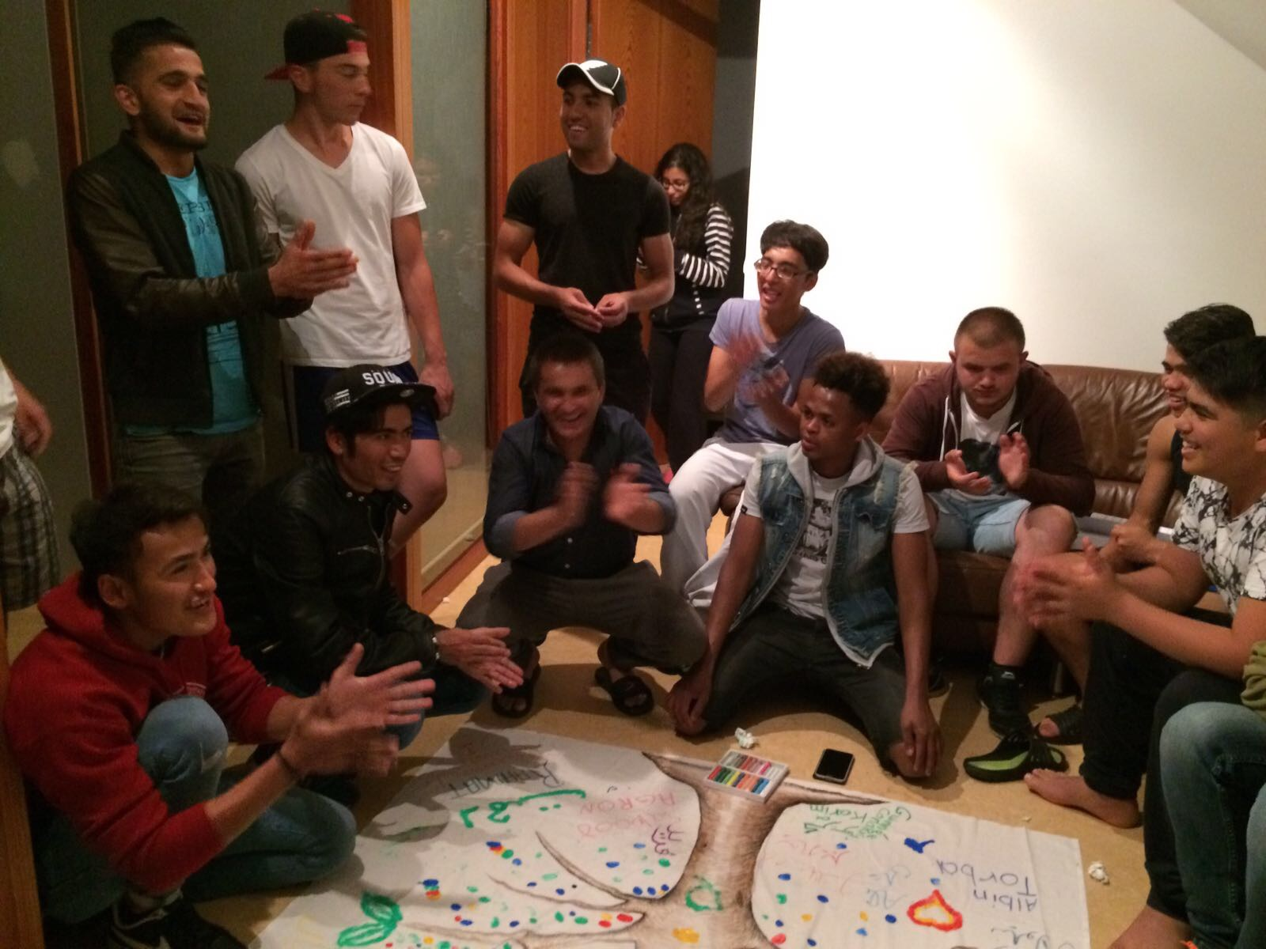

Slide 37
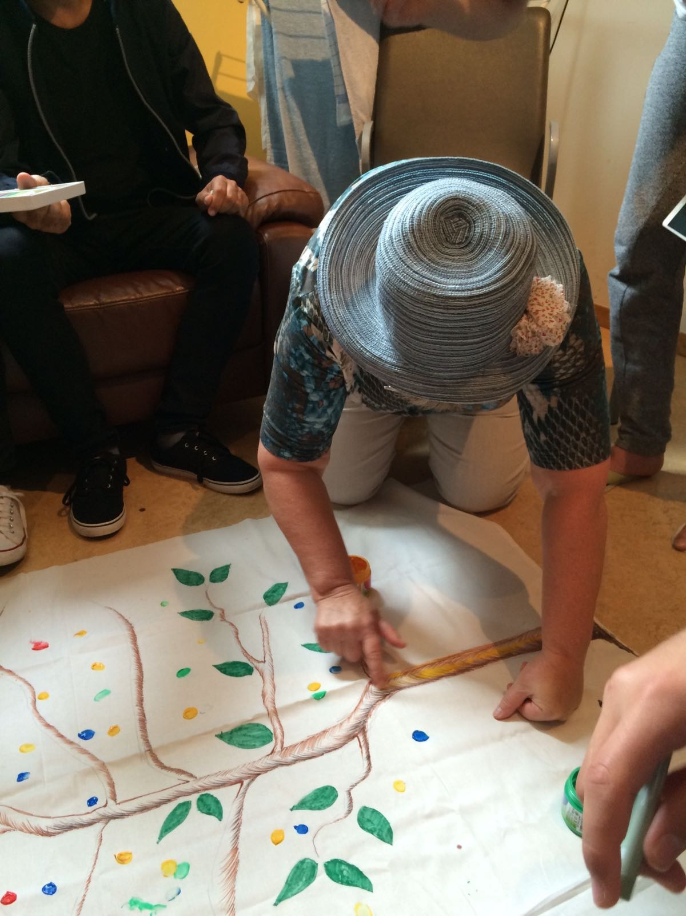

Slide 38
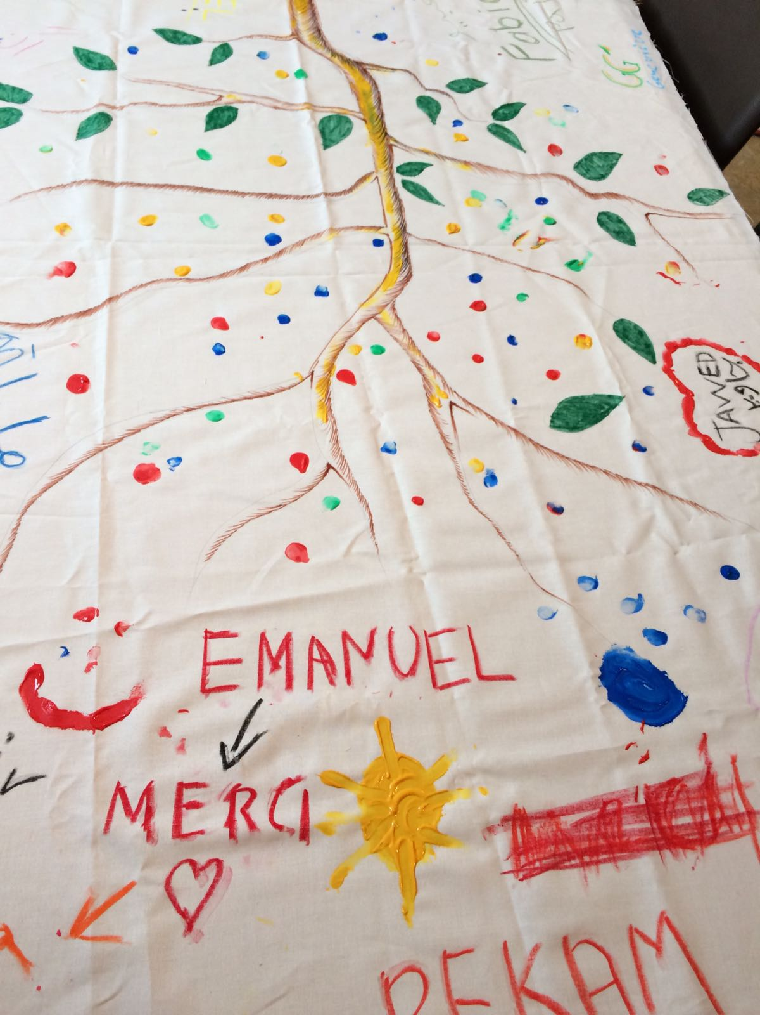

Slide 39
Vol on te er e va lua tion

Slide 40
Financial report
dépenses prévues | alimentation | loisirs+excursion | transport | hébergement | divers | total
location |  |  |  | 2500
draps |  |  |  | 265
produits nettoyage |  |  |  |  | 50
1er groupe | 1400 | 1000
2e groupe | 1260 | 900
3e groupe | 840 | 560
4 tickets mensuels |  |  | 200
Tickets d’avion |  |  | 872,25
divers |  |  |  |  | 150
budget | 3500 | 2460 | 200 | 2765 | 200 | 9125
réalisé | 2551,54 | 1798,64 | 970,25 | 2500 | 37,49 | 7857,92
recettes
REH-diocese | 2625
RDC-religious order | 2000
CVX | 2000
Caritas | 1232,92

Slide 41
See you, next year?

